Slide 1


AMAZON SALES DATA- ANALYSIS
BY: SHILPA NAGPAL

Slide 2

PROBLEM STATEMENT
Sales management has gained importance to meet increasing competition and the need for improved methods of distribution to reduce cost and to increase profits. Sales management today is the most important function in a commercial and business enterprise.
Do ETL: Extract-Transform-Load some Amazon dataset and find for me Sales-trend -> month-wise, year-wise, yearly month-wise. Find key metrics and factors and show the meaningful relationships between attributes.
Do your own research and come up with your findings.
PROJECT TITLE | Analysing Amazon Sales Data
TECHNOLOGY | Data Science
DOMAIN | E-Commerce
PROJECT DIFFICULTY LEVEL | Advanced
PROGRAMMING LANGUAGE USED | Python
TOOLS USED | Jupyter Notebook, MS-Excel, Tableau
Notes:
Source images : Powerpoint Stock Images

Slide 3
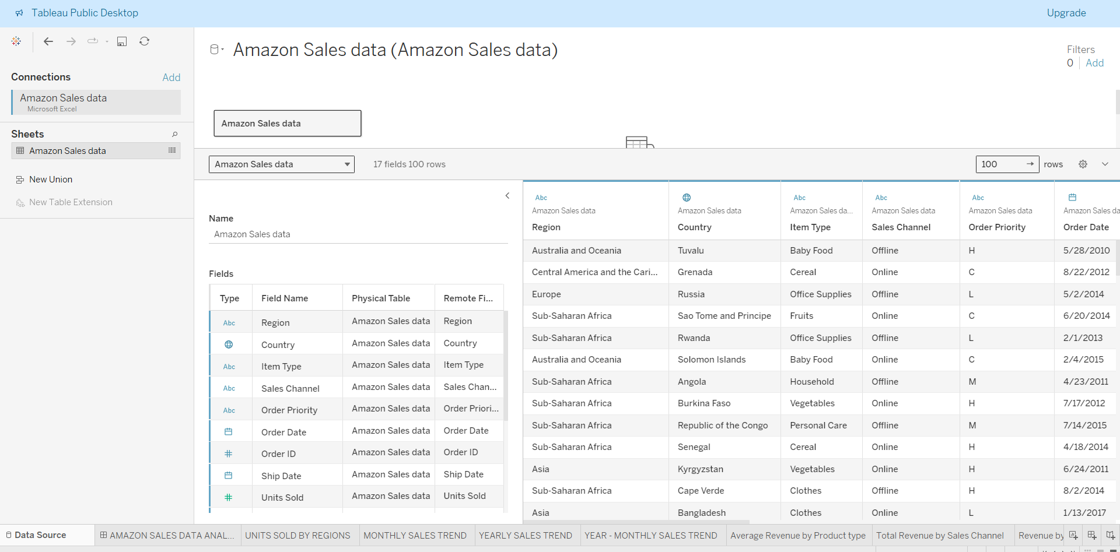
DATA SOURCE

Slide 4
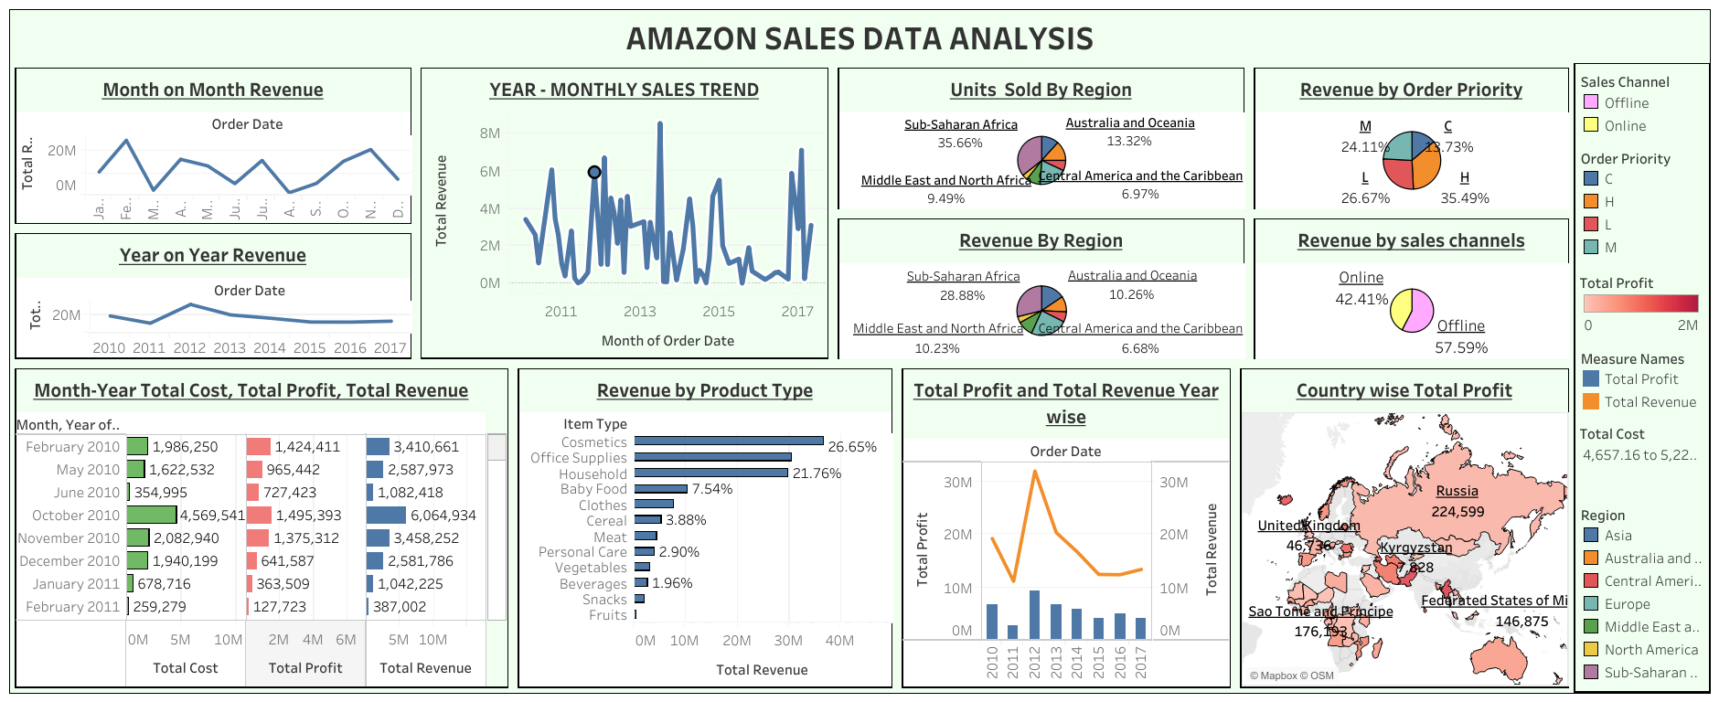
DASHBOARD

Slide 5
INSIGHTS
Top 5 Gross Profit Margin Categories: Cosmetics, Households, Office Supplies, Clothes, and Baby Food are the top-performing categories in terms of gross profit margin.
Profit Percentage by Sales Channels: Online sales contribute to 44% of the total profit, while offline sales contribute to the remaining 56%
Profit Percentage by Customer Preferences: High-priority customer preferences generate 38% of the total profit, followed by the least priority (25%), medium (22%), and cancels (15%).
Monthly Trends: February, July, and November exhibit the highest number of orders, while March, June, and August show the Lowest order volumes.
Profit Percentage by Regions: Europe and Sub-Saharan Africa are the most profitable regions, contributing 25% and 28% respectively to the total profit. Other significant regions include Asia (14%), Australia and Oceania (11%), Central America and the Caribbean (6%), and Middle East & North America (13%).
Most Profitable Countries: Djibouti and Myanmar emerge as the most profitable countries within the regions analyzed.

